Slide 1
New & Emerging Technologies in FR and Intumescent Polymer Compounds
Edward C. Gregor
Managing Director
Edward C. Gregor & Associates, LLC

Slide 2


New & Emerging Technology

Slide 3
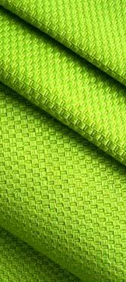
Flexible PVC. One Of The
Most Versatile And Useful
Plastics Made Today.
3rd Largest Volume Thermoplastic Globally
Cross-Head Extruded Yarns (Roller Shades)
Coated Fabrics (Billboards, Banners, Tents, etc.)
Contact Fabrics (Wall Coverings, Resilient Flooring, Curtains)
Truck, Auto, Camper Interiors (Seating, Dashboard, Door Panels, Headliners, etc.
Pond & Swimming Pool Liners/Shower Curtains
Children’s Bedding, Cribs, Toys, Pacifiers

Slide 4
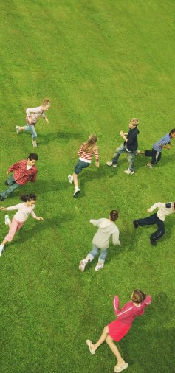
Flexible PVC:
Impact On Health
Arguably, Flexible PVC is One of The Most Toxic
– Phthalates, Heavy Metals, Vinyl Chloride, Halogens, Dioxins
Center for Health, Environment and Justice Calls PVC: “The Poison Plastic”
– Campaign to eliminate it’s use in nurseries, schools, elsewhere where children are present
US Government Consumer Product Safety Commission
– Banned 6 largest volume plasticizers used in flexible PVC in children's bedding, cribs, car seats effective Winter of 2010
National, State, Local Governments
– Germany, Sweden, Spain - Now European Union
– Boston, Buffalo, NYC, San Francisco, Seattle, etc.
– Kaiser Permanente’s Hospitals

Slide 5
20th Century 21st Century Opportunity
Sustainable Sustainable Health Personal well-being
PVC Non-toxic Clean products
“Poison Plastic” replacement
“Are you green?” Conscious of Build trust and processes transparency
Commodity Innovation driven Brand advantage
pricing value propositions and differentiation
for “brand-owner”

Slide 6










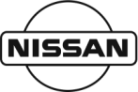
















Elimination of PVC in products or packaging

Slide 7
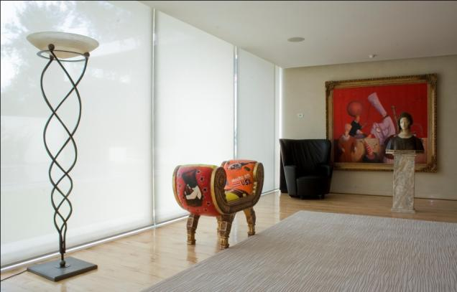
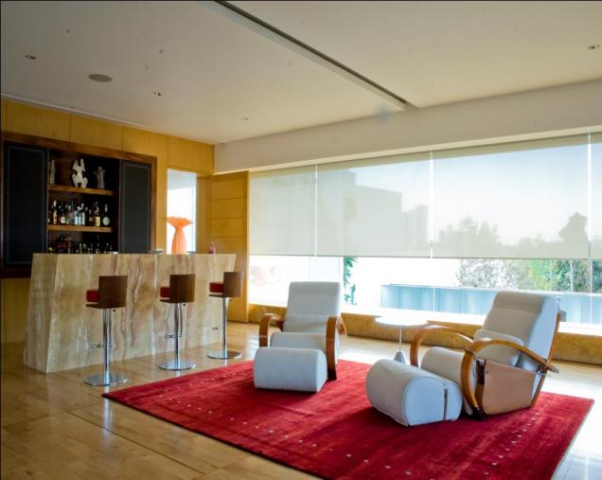
Alternative Compounds to Replace PVC in a Variety of Applications
No Phthalates, Heavy Metals or detectable halogens/bromines during combustion, extremely low smoke density & VOC’s
Processable on same extrusion equipment as PVC and other Thermoplastics
Cradle to Cradle recyclable for targeted constructions
Used with Permission: Window roller shades with Phifer Incorporated's SheerWeave Infinity fabric.

Slide 8
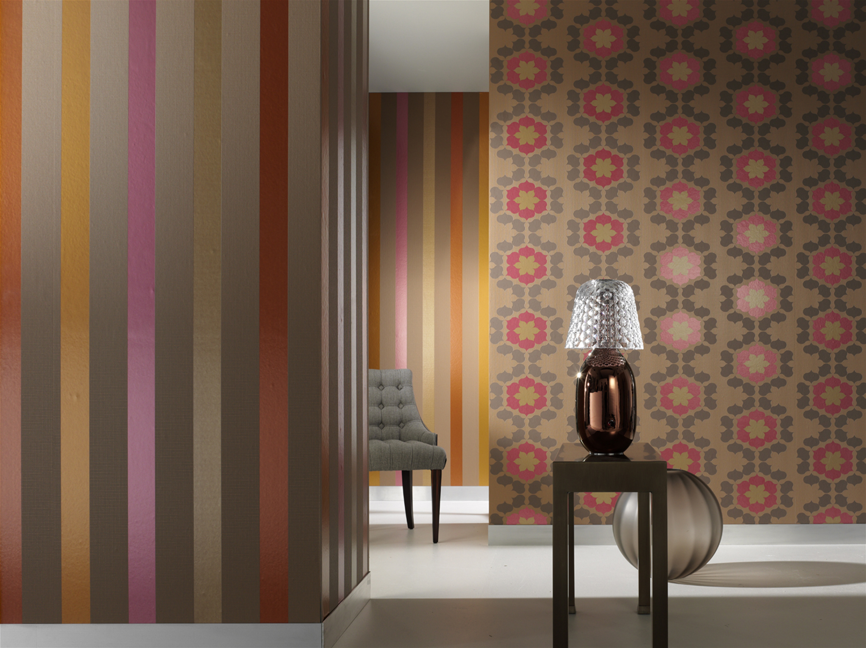
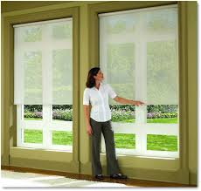
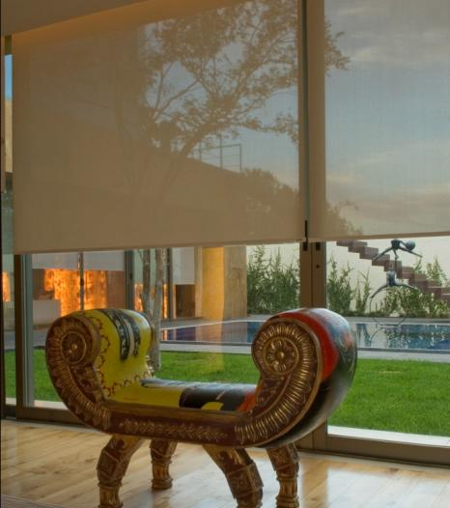
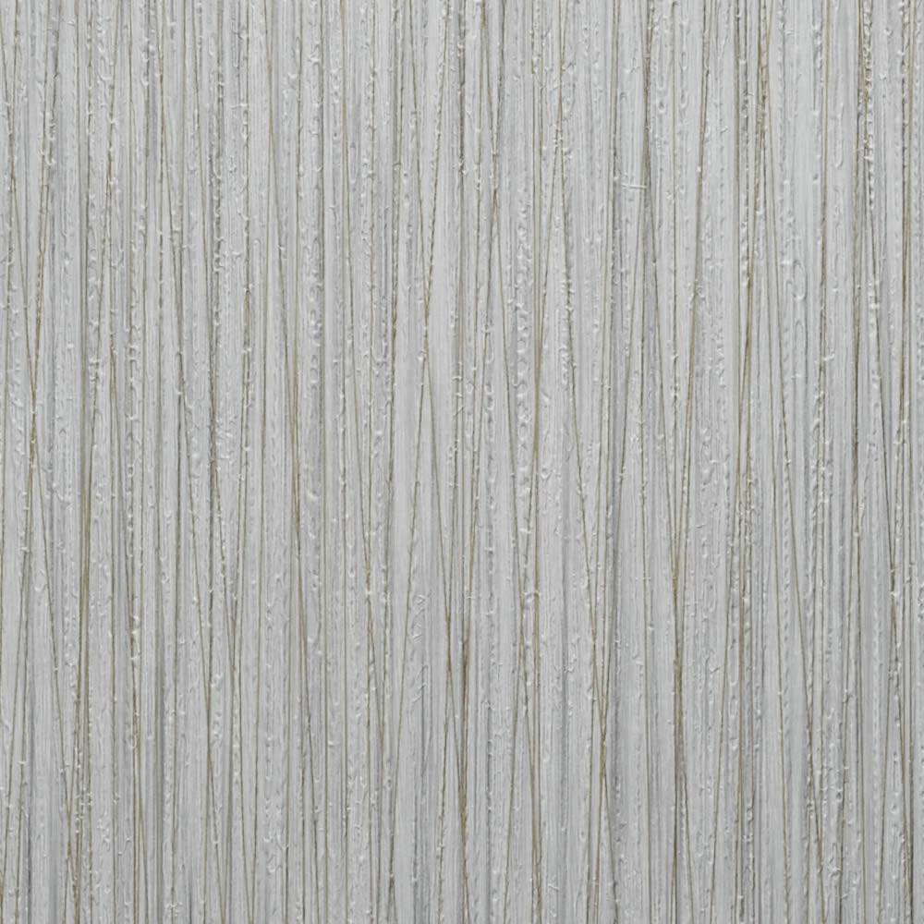
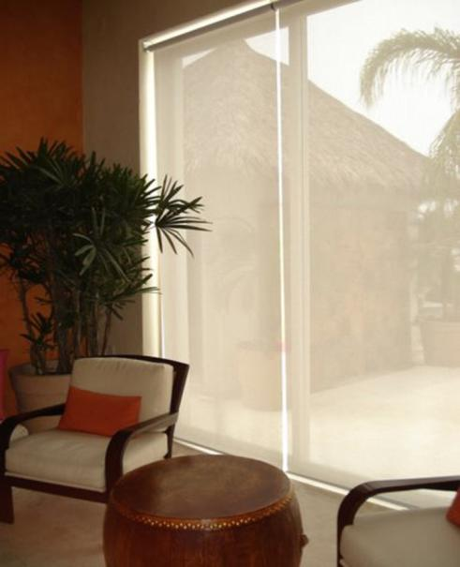
Alternative Plastic For Textile & Coated Fabric Use
• Custom tailored to the end use application
• 0.89 to 1.00 specific gravity for flame retardant grades
• Building block in bio-based versions in development
Recipient of R&D 100 Award from R&D
Magazine

Slide 9
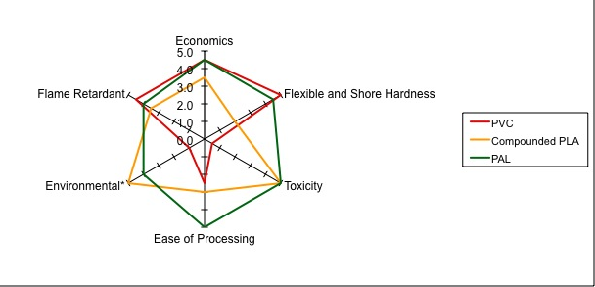
Property Comparison – Polymer Spider Chart
(PVC Alternative)

Slide 10

Sustainable Health
Does Not Contain Any Detectable:
Phthalates
Vinyl Chloride
Heavy Metals
Halogens/Bromine
Dioxins
Can be used as a cradle to cradle offering:
Recyclable – post-industrial/ consumer waste
Impact Modifier: Transportation products and pallets
Interior uses where people gather.
Sustainable

Slide 11

Sustainability Creed Leave No Footprint Behind

Slide 12
More Applications of Alternative Compounds to Replace PVC
Practical end-uses
Barrier Films, fibers, printed signage, labels and surface wraps
Contract Fabrics: wall coverings, upholstery & nonwoven fabrics
Coated fabrics, coated paper, films, Sheet, co-extrusions
Barrier films, resilient flooring tiles, carpet, fibers
Common Processing Methods
Extrusion / calendering / cast films / profiles
Calendering/Injection Molding/Extrusion & Blown Films (FR only)/ Molded Products
Xxxxxxxxxx
xxxxxxxxxx.

Slide 13
Custom Compounds to Replace Flexible PVC
Compounds can include other specialty attributes:
Examples: Color, UV resistance, Anti-microbial, Surface Modifiers, Flow Enhancers, etc. all tailored to the use processes and application.
Two distinct flame retardant systems used to provide a solution to replace flexible PVC while maintaining sustainability.
Vapor Phase FR’s: Commonly used flame retardant additives dispersed into the polymeric compound that inhibit combustion via chemically interfering with the combustion process. Vapor phase FR systems are either halogenated (brominated) or highly synergized brominated systems (very low bromine).
Intumescent: Flame retardant additives dispersed into the polymeric compound that inhibit combustion through the formation of a physical char layer. Often there are no flaming drips and higher levels of flame retardancy are possible meeting difficult FR specifications. 100% Non-Halogenated.
.

Slide 14
Recent Advances in the State-of- the-Art of Intumescent FR Systems
Various formulations to replace flexible PVC and other polymers for TODAYS market needs
Flexible Intumescent Compounds used for:
Commercial Wall Coverings, Technical Textiles, etc.
Technical Textile Composite Constructions
Stiff Compounds (Rigid Grades)
Barrier moldings/sheeting, Partitions, O&G Platforms
All of the above are non-toxic, low-smoke generation, non-halogenated and sustainable

Slide 15
Intumescent Adhesive/Lamination Grades
Composite Laminate Applications
Sheet or film is formed from the Intumescent compound and sandwiched between woven carbon fiber or glass fabrics
Calendaring is recommended as sheet/film formation process
Excellent flame retardant properties of the sandwiched composites formed.
Excellent adhesion of the intumescent compound to the carbon or glass fabrics.

Slide 16
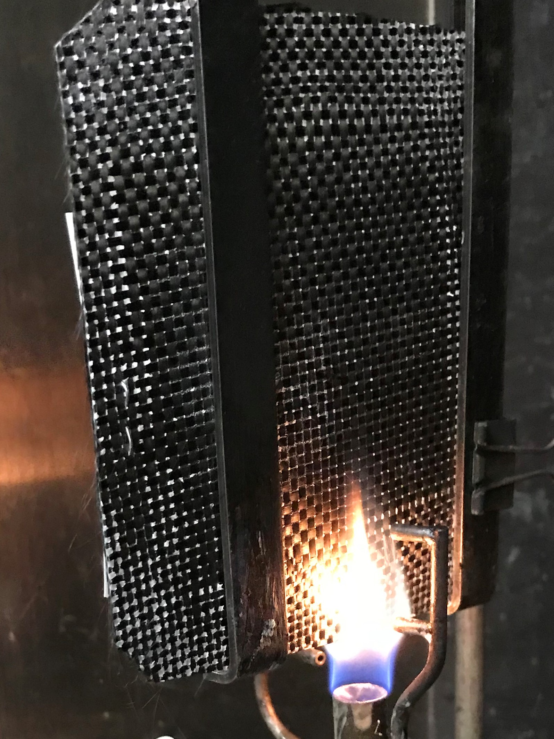
Woven Carbon Fiber & Glass Fabric Laminates
One Layer Intumescent Compound in center of the Sandwich (two layer fabric)
60 Second vertical burn
1,900 degree flame
Composite construction using extrusion lamination at the nip

Slide 17
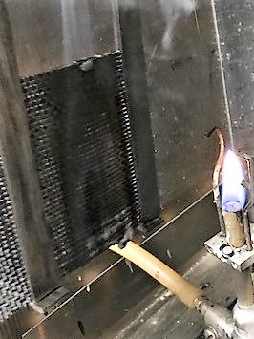
Post-Carbon Fiber / 60 sec. Burn

Slide 18
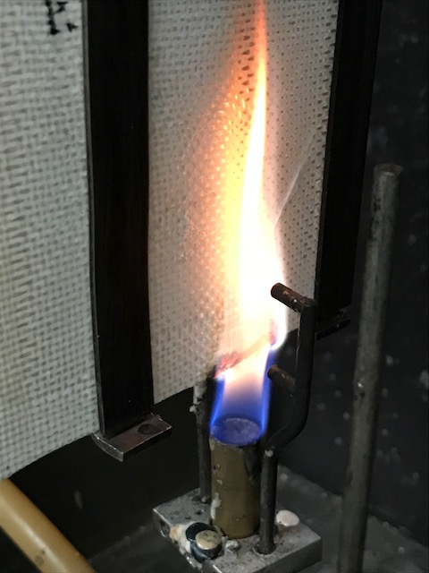
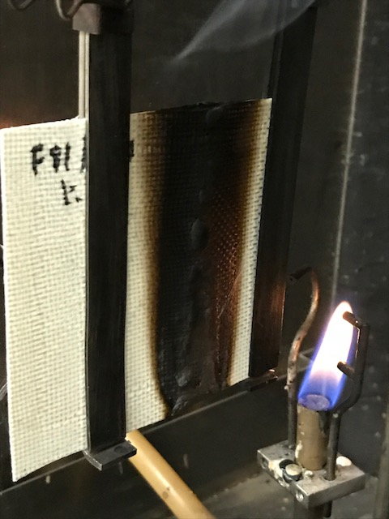
Intumescent /Glass - 60 sec. Burn

Slide 19
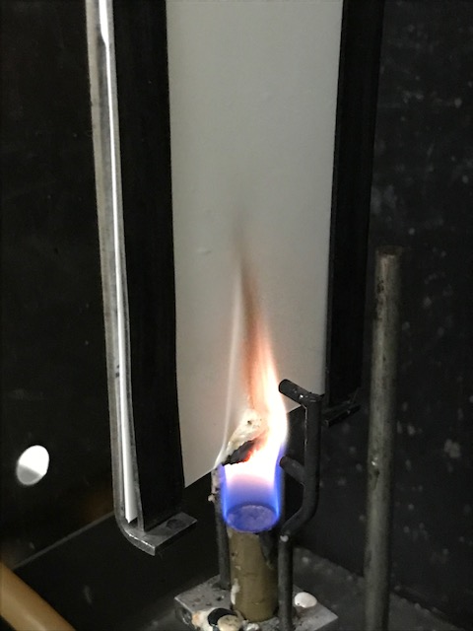
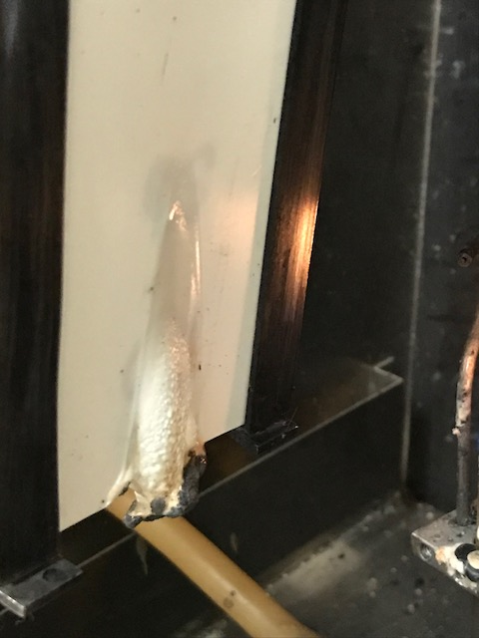
Intumescent Flexible Molded Plaque in 60 Sec. Vertical Burn

Slide 20
Key Takeaways
State-of-the-art FR and Intumescent Compounds
Both <Custom Tailorable> Rigid and Flexible Grades Available
Cost Effective (< $5/lb.)
Likely will pass more demanding FR specifications (e.g. Class “A” rating in Steiner Tunnel Test: ASTM E84 )
Undetectable toxicity of combustion gases, low-smoke generation and sustainable
Can be applied to multi-substrates: woven, paper, nonwovens
Film, sheet and molded products are all possible with intumescent compounds
Other properties easily formulated into intumescent compounds: Custom Colors, UV Resistance, Special Surface Properties, Anti-blocking Properties, Anti-microbial, and many other properties via additives/modifier additions.
Many end-use commercial applications
From interiors and building exteriors, where people gather and protection of valuable assets.
e.g. offices, schools, theaters. churches, hospitals, aircraft, casinos, malls, busses/rail, restaurants, hotels, arenas

Slide 21



Slide 22
Thank you for your attention
Edward C. Gregor
Managing Director
Edward C. Gregor & Associates, LLC

